Slide 1
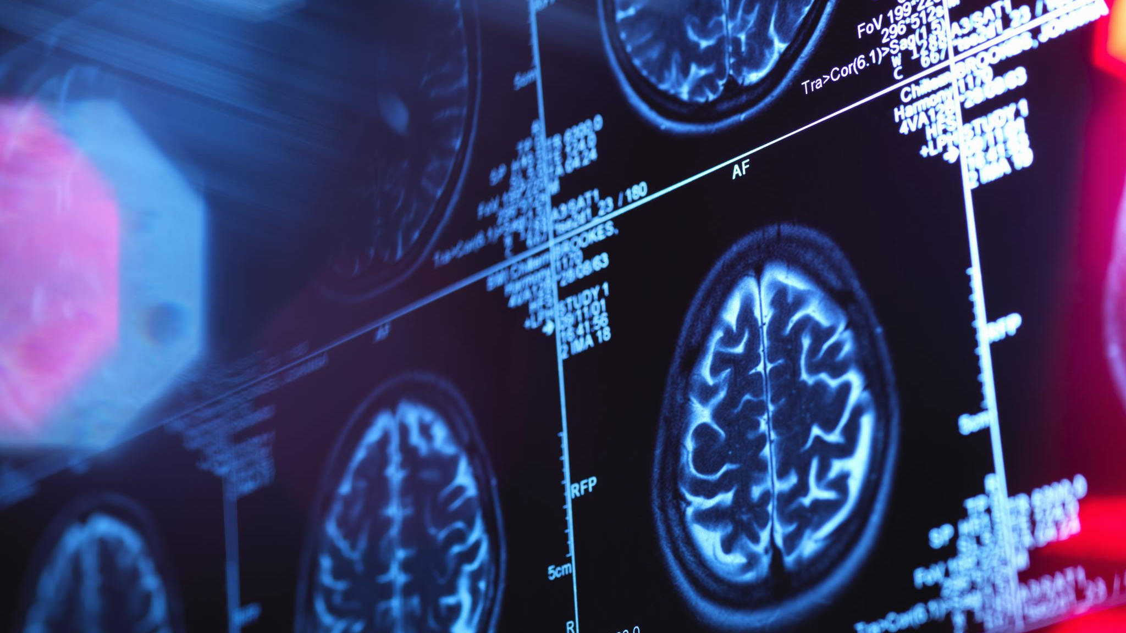
MRI-PET Image Fusion Using CNN
Student Name: Muhammed Kenan
Student Surname: Kayıkci
Student ID: 20200205007
Department: Information Systems Engineering
Student Name: Selin
Student Surname: Suvancıoğlu
Student ID: 20190205026
Department: Information Systems Engineering
Student Name: Naci Eren
Student Surname: Kılıç
Student ID: 20190205002
Department: Information Systems Engineering

Slide 2
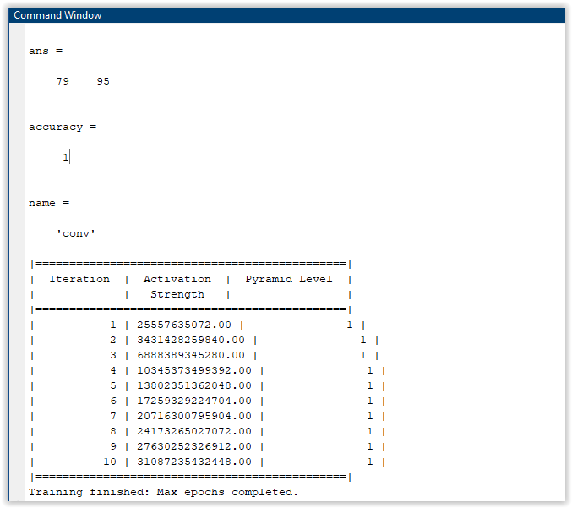
Results
Ans variable
Height of the image: 79 pixels --- Width of the image: 95 pixels
Accuracy
Accuracy = 1, it indicates 100% accuracy.
Name
Name = 'conv'
Iterations
Total of 10 iterations
Activation Strength
These values represent the level of focus in the model's learning process.
Pyramid Level
Set to 1 for all iterations

Slide 3
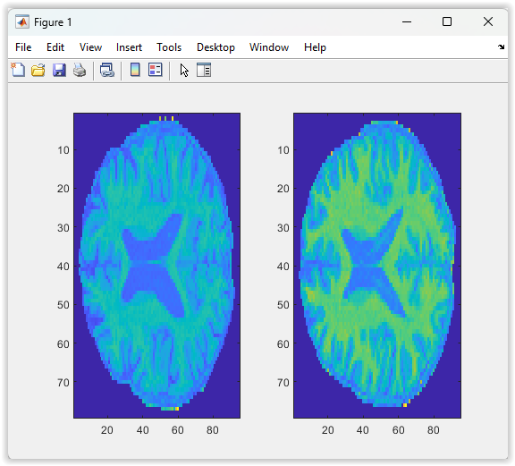
Image Plot
CT (Computed Tomography):
Basic Principle: Computed Tomography is a medical imaging technique that utilizes X-rays to create detailed cross-sectional images inside the body.
MR (Magnetic Resonance):
Basic Principle: Magnetic Resonance is an imaging technique that obtains detailed images inside the body using a strong magnetic field and radio waves.

Slide 4
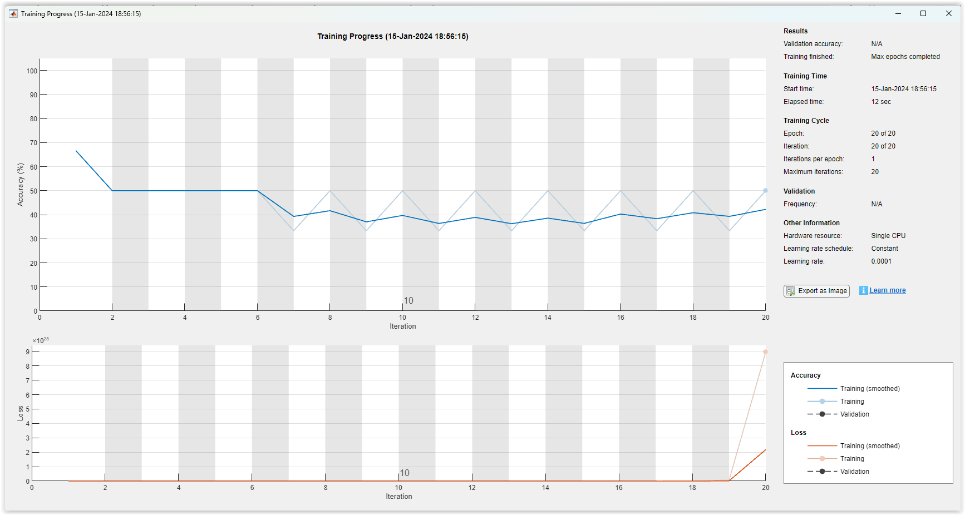
Training Progress
Accuracy: This graph shows the accuracy rate on the training and validation datasets. High accuracy rates indicate how well the model fits both the training data and new data.
Loss: The loss graph measures the errors made by the model during training. Loss represents how far the model's predictions are from the true labels.

Slide 5
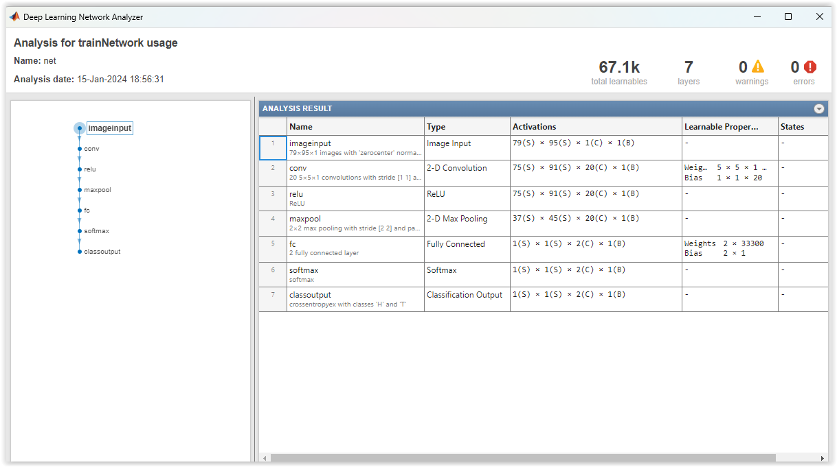
Analysis For Trainnetwork Usage (Name: net)
imageInputLayer ([79 95 1]): This is the input layer, processing grayscale images of size 79x95 pixels.
convolution2dLayer (5,20): This is a convolutional layer. It contains 20 filters of size 5x5. These filters are used to extract features from the input image.
reluLayer: This layer includes the Rectified Linear Unit (ReLU) activation function. It takes the results of convolution and introduces non-linearity by setting negative values to zero.
maxPooling2dLayer (2, 'Stride', 2): This layer is a max-pooling layer. It is used to reduce the size of the image and highlight features. The pooling operation uses a window of size 2x2.
fullyConnectedLayer (2): This is a fully connected layer. It contains 2 neurons and represents the output classes. In this example, there are two classes: "tumor present/absent."
softmaxLayer: This layer includes the Softmax activation function. It normalizes the outputs to a range between 0 and 1, providing a probability distribution.
classificationLayer: This is the classification layer. It calculates the cross-entropy loss and produces the classification results.

Slide 6
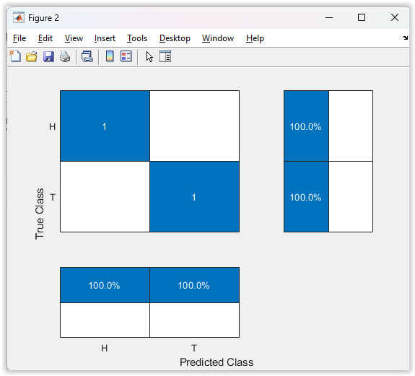
True Class & Predicted Class
True Class: This represents the actual classes.
Predicted Class: This represents the classes predicted by the model.
H (Hit): This represents correctly classified instances.
T (True): This represents the true class.
1 (One): This indicates that the classification is related to the "tumor present" class.

Slide 7
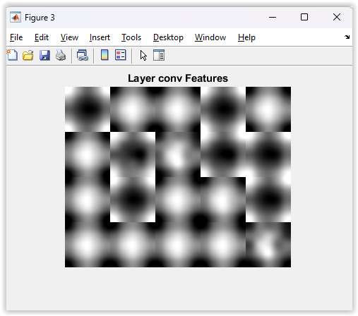
Layer Conv Features
The black and white icons in the Layer Conv Features output represent that each feature map captures a specific feature or pattern from the input image. These feature maps highlight significant features and objects learned by the network. Such visualizations can be used to understand the learning process of the model and visually observe which features the model is focusing on.

Slide 8
REFERENCES
[1] The MathWorks, Inc., 1994. https://www.mathworks.com/.

